Slide 1
Tasks-based structure ساختار مبتنی بر وظایف
تیر ماه 1398

Slide 2
وظایف از کجا می آیند؟
Mission
& Vision
Goals & Objects
Goals & Objects
Specific Objectives
Specific Objectives
Specific Objectives
Specific Objectives
Specific Objectives
Specific Objectives
Tasks
Tasks
Tasks
Tasks
Tasks
Tasks
Tasks
Tasks
Tasks
Tasks
Tasks
Tasks
Tasks
Tasks
Tasks
Tasks
Tasks
Tasks
Tasks
Tasks
Tasks
Tasks
Tasks
Tasks

Slide 3
Mission
& Vision
Goals & Objects
Goals & Objects
Specific Objectives
Specific Objectives
Specific Objectives
Specific Objectives
Specific Objectives
Specific Objectives
Tasks
Tasks
Tasks
Tasks
Tasks
Tasks
Tasks
Tasks
Tasks
Tasks
Tasks
Tasks
Tasks
Tasks
Tasks
Tasks
Tasks
Tasks
Tasks
Tasks
Tasks
Tasks
Tasks
Tasks
Employee
Employee
Supervisor
Employee
Manager
Employee
Supervisor
Employee
Employee

Slide 4
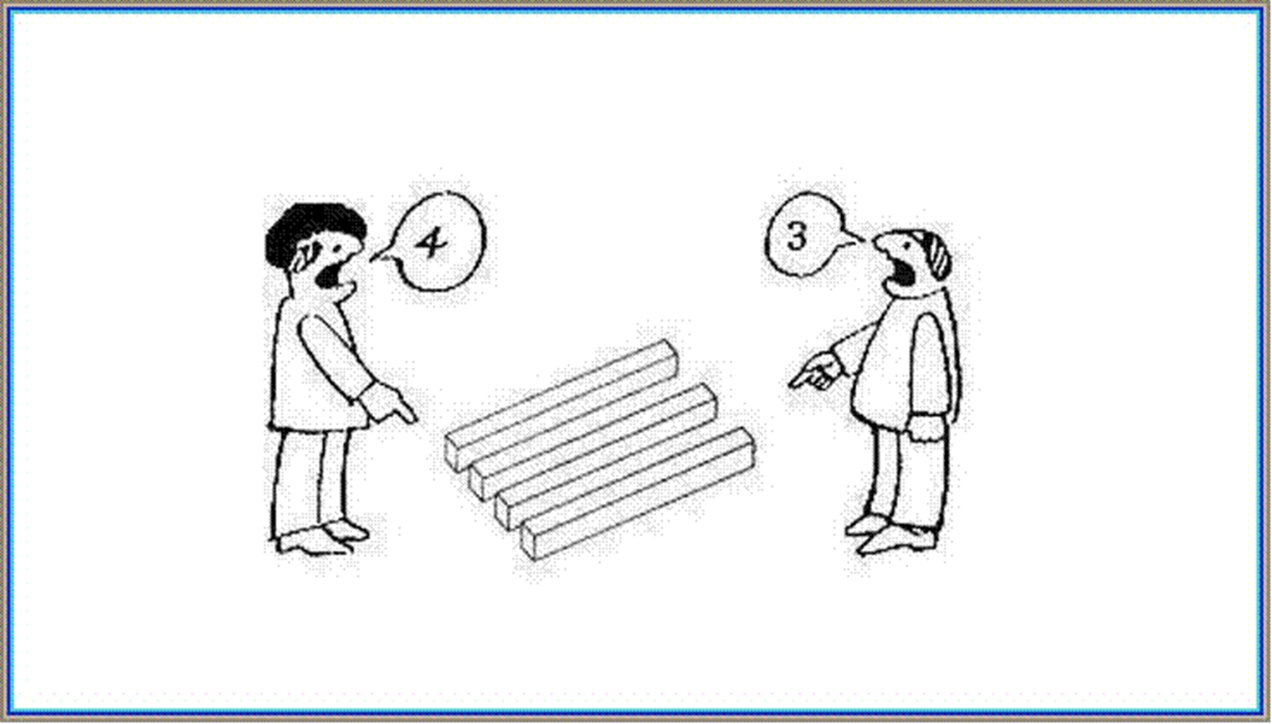
با تشکر از توجه شما

